Slide 1
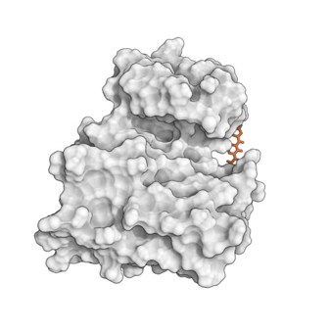
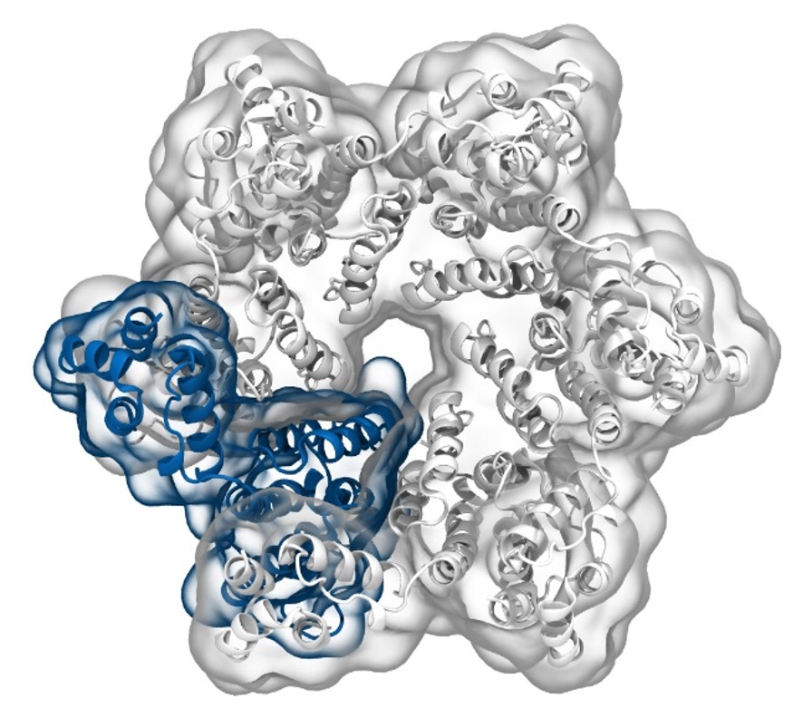
Simulation of Biomolecules
Docking*
2024 CCP5 Summer School
*Some material adapted from Dr Agnieszka Bronowska
Dr Matteo Degiacomi
Durham University
matteo.t.degiacomi@durham.ac.uk
Dr Antonia Mey
University of Edinburgh
antonia.mey@ed.ac.uk

Slide 2
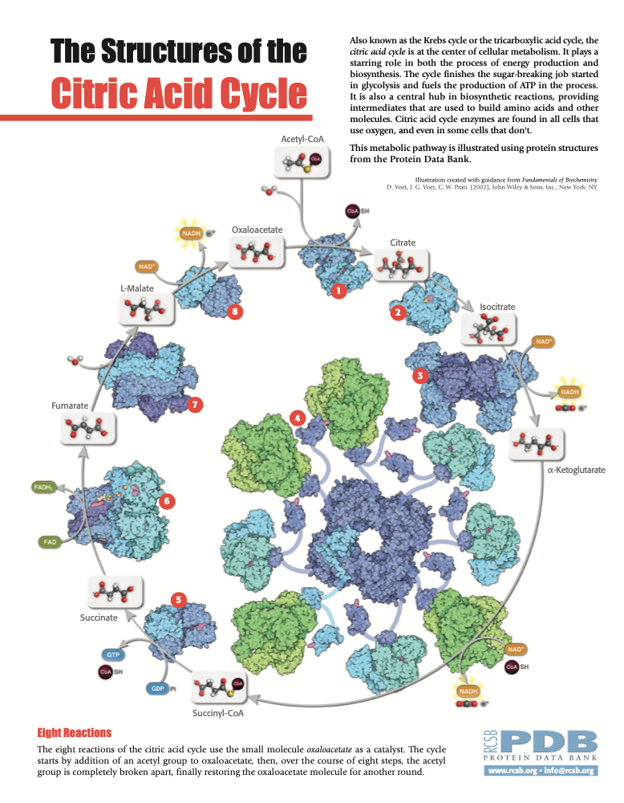
Life is built on protein and small molecule interactions
Small molecules are:
substrates of enzymes
Inhibitors or activators
Co-factors
And play an important role in life.
Accurate interaction prediction is essential
2

Slide 3
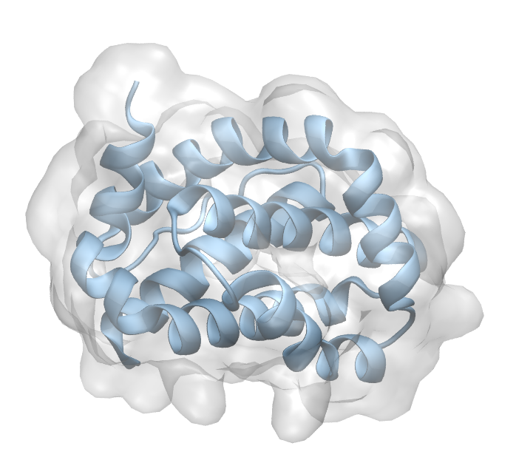
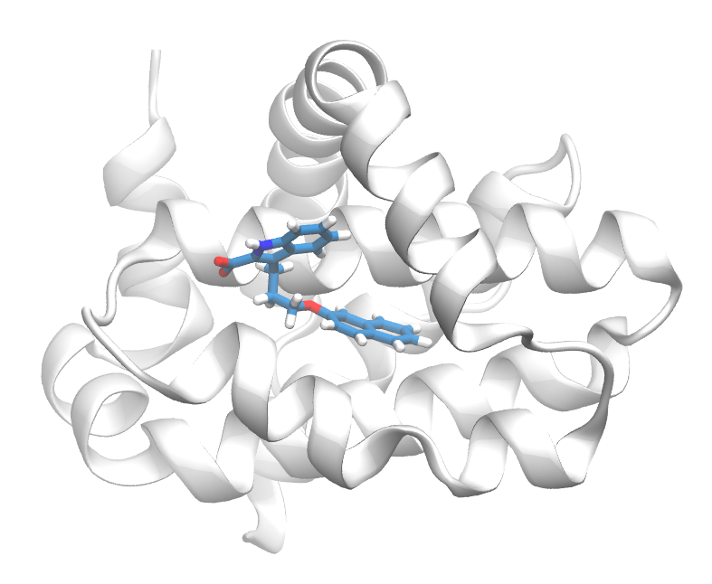
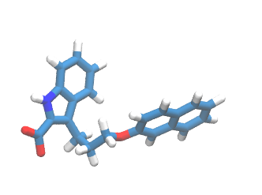
What is docking?
The process of predicting a stable 3D geometry of an interacting pair of molecules – a binding mode/pose.
3

Slide 4
Nomanclature
Ligand: Structure (usually a small molecule) that binds to the binding site.
Receptor: Structure (usually a protein) that contains the active binding site.
Binding site: Set of aminoacids (residues) that physically interact with the lingad (usually within 6 Ångstroms).
4

Slide 5
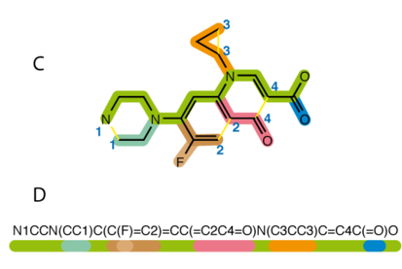
Typical workflow
1-D, or 2-D ligand structure
Find pocket
Search algorithm
Scoring function
Docking assessment
Typically Protein X-ray structure
5

Slide 6
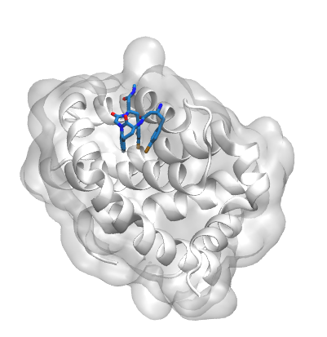
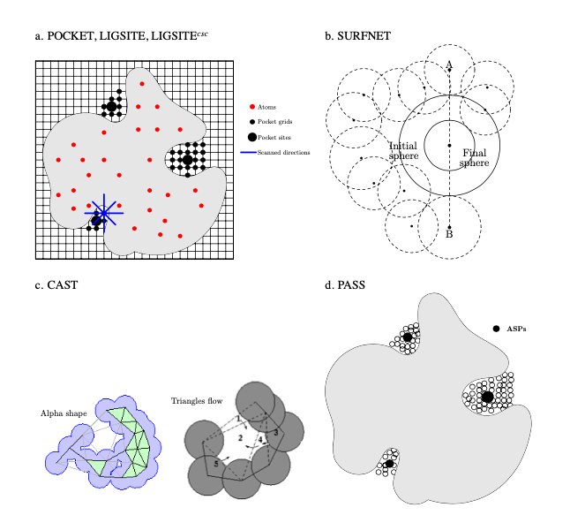
Finding a pocket
5KU9
Using a X-ray structure with an existing molecule bound
Using a pocket finding algorithm
BMC Structural Biology 2006, 6:19 doi:10.1186/1472-6807-6-19
6

Slide 7
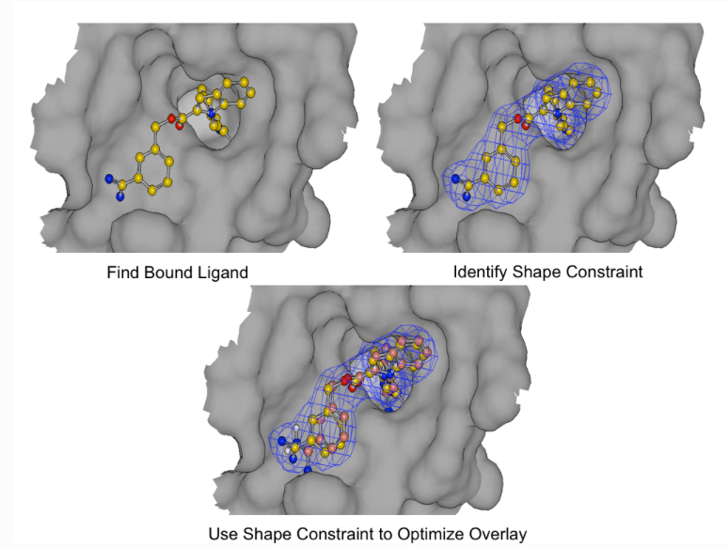
Shape based methods
With an existing ligand it is possible to match the shape and optimize the overlay
Fast and robust
Ligand changes are not taken into account
https://docs.eyesopen.com/applications/oedocking/theory/posit_theory.html#posit-heat-map
7

Slide 8
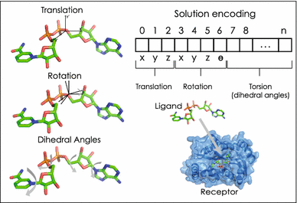
Genetic algorithm for ligand conformers
Testing different arrangements of the ligand in the rigid binding site of the protein
8

Slide 9
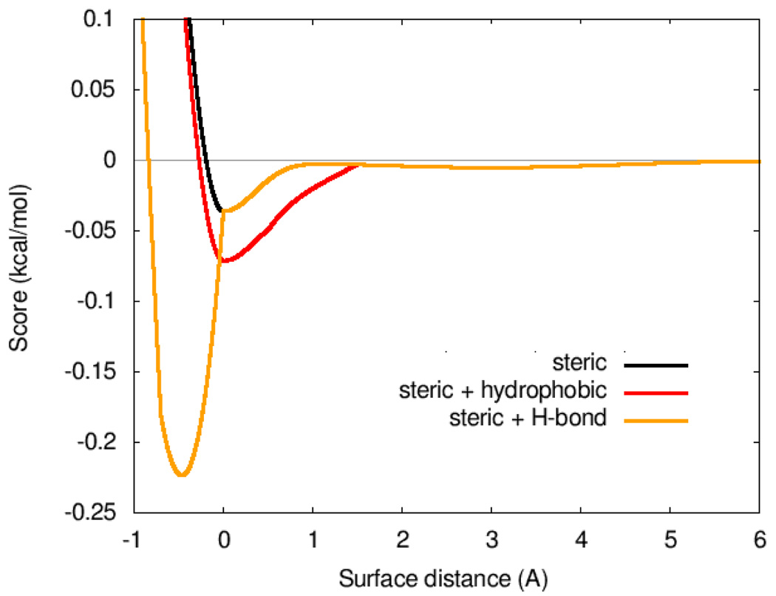
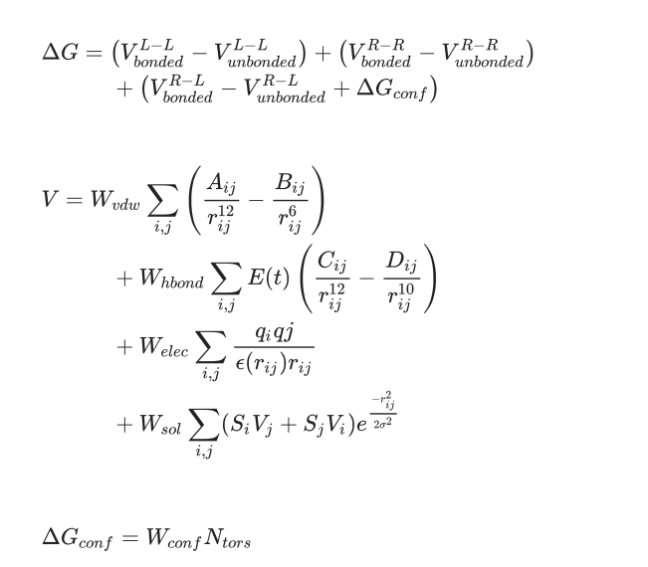
Scoring functions
Weight | Term
−0.0356 | gauss₁
−0.00516 | gauss₂
0.840 | repulsion
−0.0351 | hydrophobic
−0.587 | hydrogen bonding
0.0585 | N_{rot}
Scoring functions can be used beyond shape optimization to optimize ligand and protein interactions
J Comput Chem. 2010 Jan 30; 31(2): 455–461.
Soft Comput 23, 4155–4176 (2019).
9

Slide 10
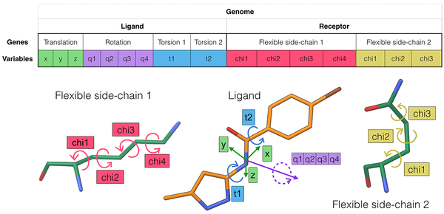
Allowing protein and ligand flexibility is often better
10

Slide 11
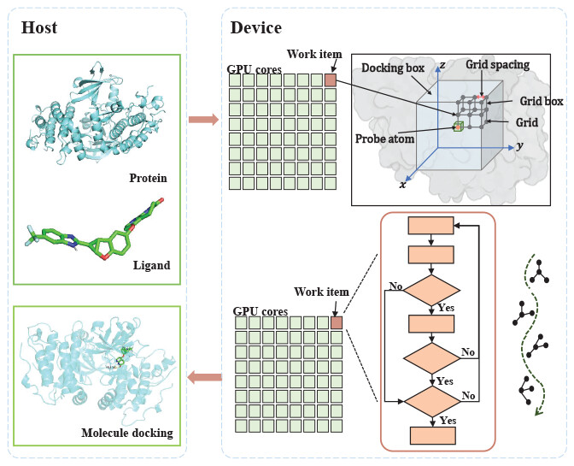
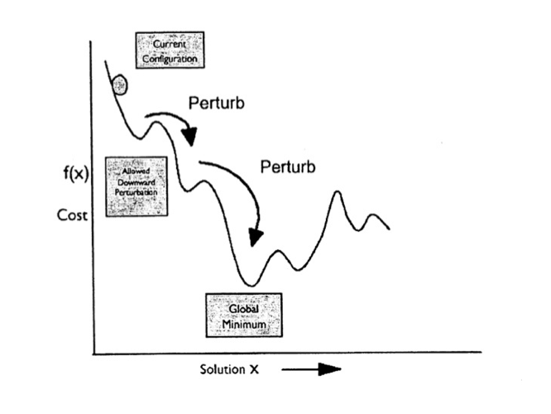
Flexibility increases compute time
Simulated annealing
N=T360/i
N: number of conformations
T: number of rotable bonds I: incremental degrees
Typical drug molecle
10 rotable bonds 30º increments (discrete)
10¹² plausible conformations!
J. Chem. Inf. Model. 2023, 63, 7, 1982–1998
https://sgt.cnag.cat/www/presentations/files/slides/20110112_Docking.pdf
11

Slide 12
Typical docking output generates multiple poses
Example output, what does it mean?
12

Slide 13
Template docking and cross docking
Example output, what does it mean?
13

Slide 14
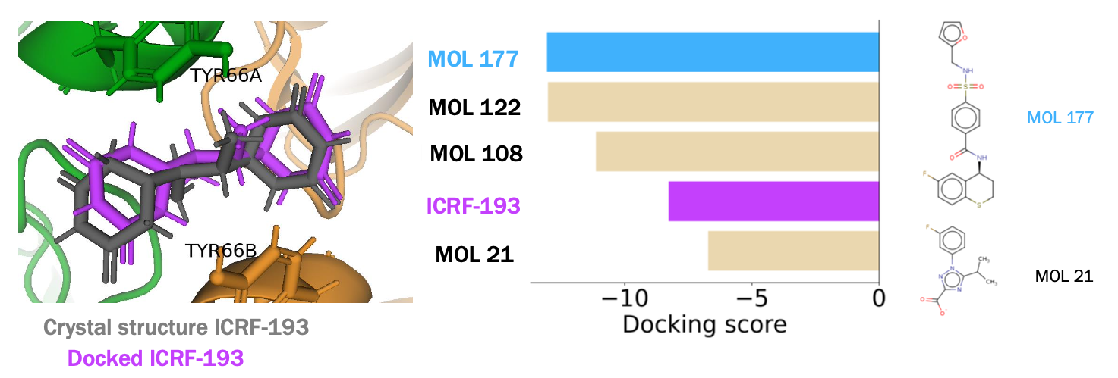
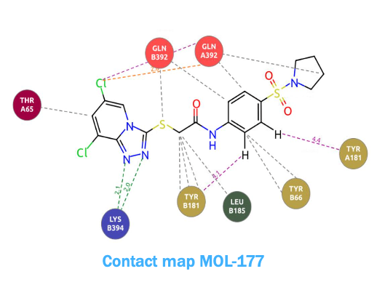
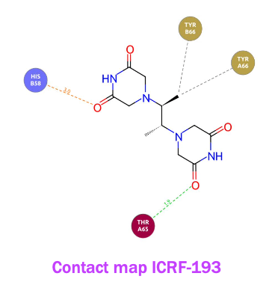
Evaluating Docked structures
14

Slide 15
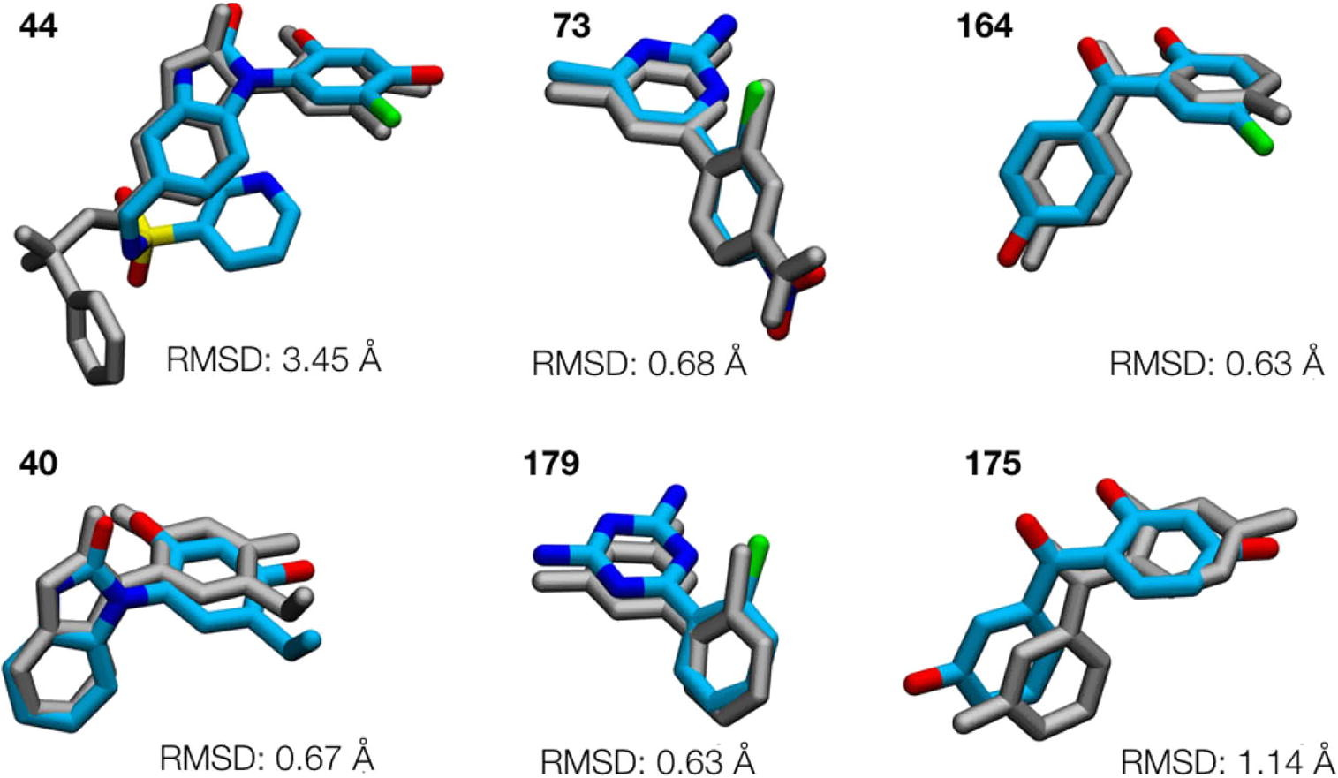
Evaluating the binding mode/pose
Bioorganic & Medicinal Chemistry
Volume 24, Issue 20, 15 October 2016, Pages 4890-4899
15

Slide 16
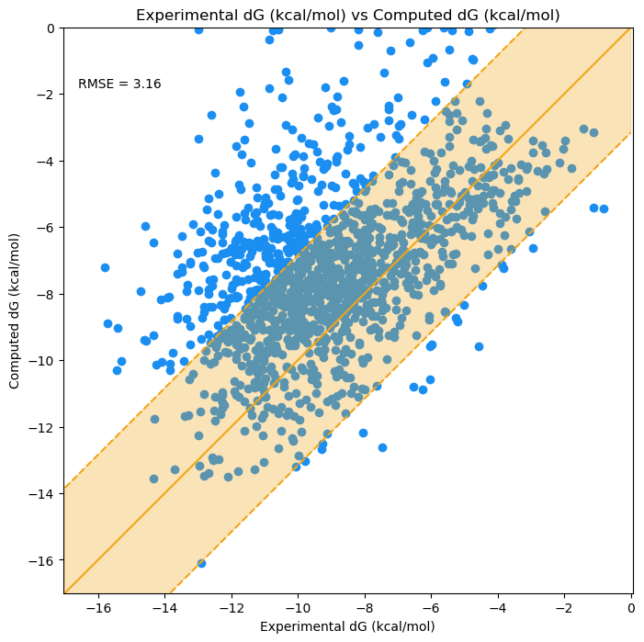
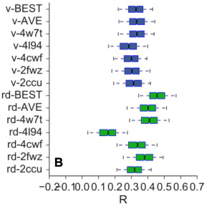
Comparing against experimental ΔG
16

Slide 17
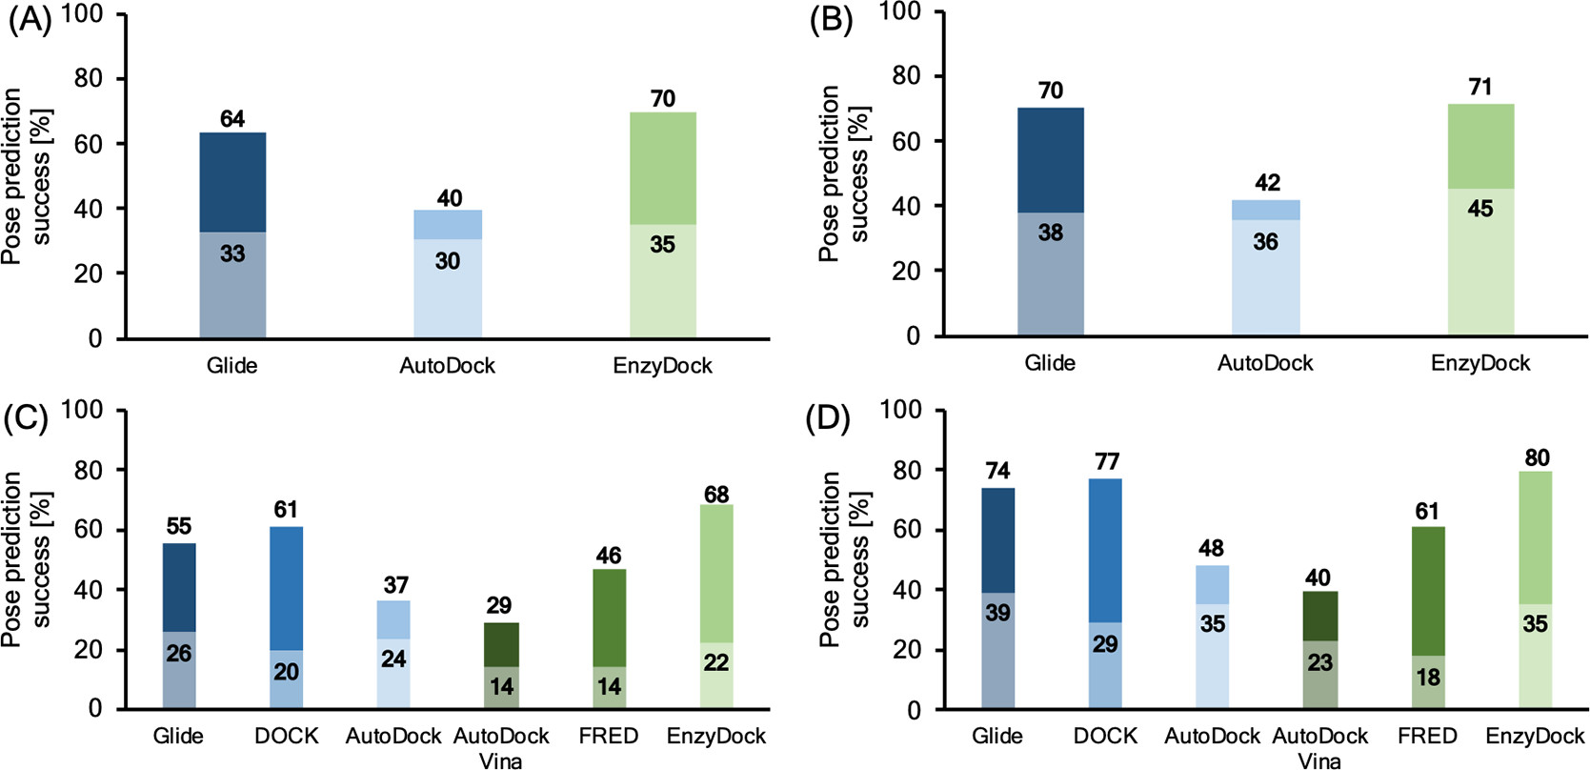
Recent docking benchmark
J. Chem. Inf. Model. 2021, 61, 6, 2957–2966
17
Notes:
Docking pose prediction success (%) for selected methods for 193 crystal structures of SARS-CoV-2 M^{pro}. For each column, the upper part represents the ability of methods to identify poses with rmsd < 2 Å, while the lower part represents ability of methods to identify a pose with rmsd < 2 Å as the lowest energy pose. (A) All 193 crystal structures, (B) 108 crystal structures with covalently bound ligands, (C) 85 crystal structures with noncovalently bound ligands, (D) 51 crystal structures with noncovalently bound ligands excluding surface bound ligands.

Slide 18
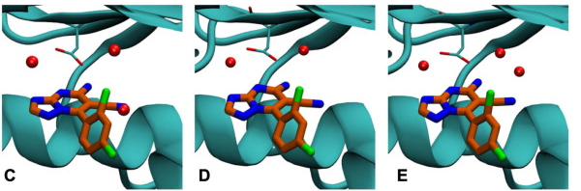
Things to worry about
pKa of ligands and binding site protonation
structural waters are important
18
Notes:
C crystal water clash with docked structure, manually moved crystal water in E

Slide 19
Scoring the pose with a scoring function
The process of predicting a stable 3D geometry of an interacting pair of molecules – a binding mode/pose.
ligand
protein
Binding pose image
19

Slide 20
Evaluating the binding mode/pose
The process of predicting a stable 3D geometry of an interacting pair of molecules – a binding mode/pose.
ligand
protein
Binding pose image
PoseBuster: Chem. Sci., 2024,15, 3130-3139
20

Slide 21
Finding the pocket in a protein
The process of predicting a stable 3D geometry of an interacting pair of molecules – a binding mode/pose.
ligand
protein
Binding pose image
21

Slide 22
Predicting a binding mode/pose
The process of predicting a stable 3D geometry of an interacting pair of molecules – a binding mode/pose.
ligand
protein
Binding pose image
22

Slide 23









What tools exist for molecular docking?
Glide
Autodock Vina
And others….
23

Slide 24
ML-based docking
Gnina
Deepdock
Difffdock
Equibind
TankBind
24

Slide 25
References
J. Chem. Inf. Model. 2010, 50, 8, 1432–1441
25

